Slide 1
Advanced Traffic Management Review 1
By:
Sumeet Omalur(RA1611008010384)
Sarthak Gupta(RA1611008010368)
Swasti Sumedha Tiwari
Tanya Mishra

Slide 2
Introduction

Slide 3
Literature Survey
The following slides contain the various papers and publications we have studied to understand and analyze the current trends of traffic management around the world, the technologies and devices used and provides an insight on the advantages and disadvantages of the current implementations

Slide 4
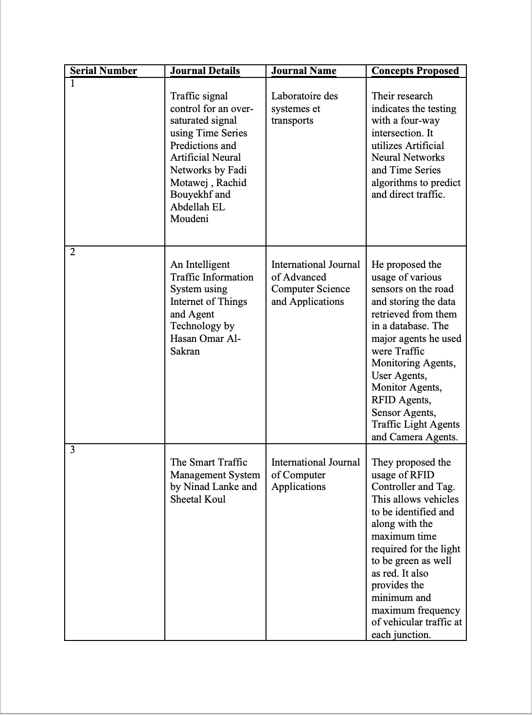

Slide 5
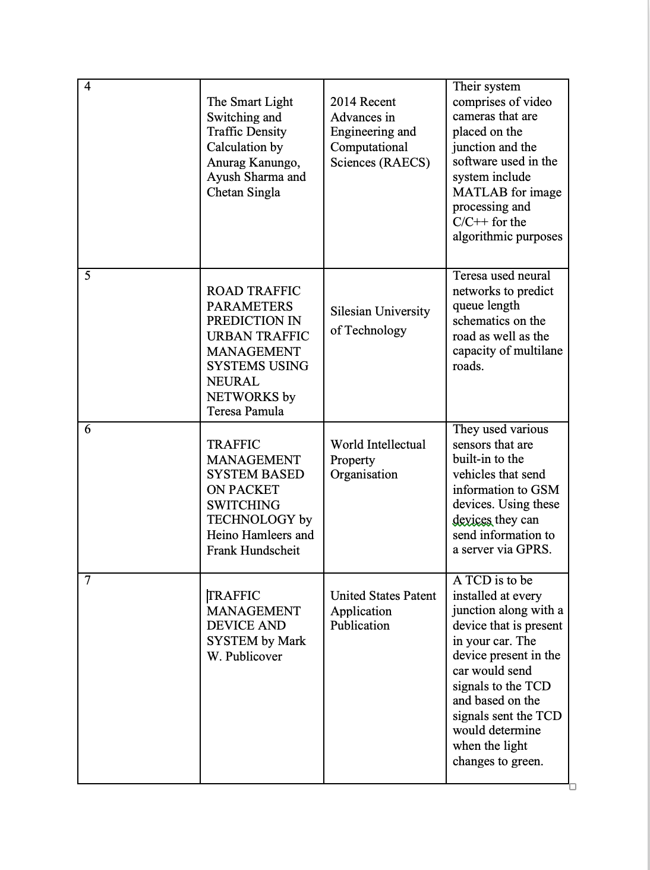

Slide 6
Conclusion’s Drawn
From the above survey we can infer the following:
Instruments such as Monitors, Cameras, RFID Sensors and Traffic Light Sensors were used to collect data from traffic signals and junctions
GSM Devices were used to transmit the result of the analysis to the users and authorized parties.
Algorithms and Technologies such as Neural Networks, Time Series, MATLAB, C/C++, Python, Anaconda were used to predict traffic flow.
The Projects were mainly hardware dependent an depended on their efficiency.

Slide 7
Requirement Analysis

Slide 8
Software Analysis
The Software we will be using to implement our project is as follows:
Anaconda Navigator: This is a dashboard that provides the a developer with libraries and tools required to implement Machine Learning algorithms and formulae. It provides tools like Jupyter Notebook, Spyder, GlueViz etc. This requires a system running Windows 7 or later/Mac OS 10.10 or later / Linux. A minimum of 5GB of disk space should available to install the software.

Slide 9
Software Analysis
Python: Python is an interactive, interpreted and open source software that is used to develop large scale machine learning applications and modules. In this project we will be using Python 3.7 that is integrated with Jupyter Notebook. Within Python 3.7 we will be utilizing libraries such as Pandas, Numpy, Pyplot, Matplotlib, and SciKit Learn.
In Conclusion our project can be executed on a system that meets the requirements that Python and Anaconda need.

Slide 10
Hardware Analysis
Advanced Traffic Management is a Software Based Project and does not utilize any form of sensors or hardware.
The End User should have a system that meets the following minimum requirements to ensure the fluidity and optimum performance of our software
Processors: Intel® Core™ i3 processor or higher
Disk space: 10 GB or More
Operating systems: Windows* 7 or later, macOS 10.10, and Linux
Python version: 3.6.X
RAM: 4GB or Higher

Slide 11
Hardware Analysis
The TCP Ports that are used are:
Inbound TCP 8080, 8443 for the Anaconda Repository.
Inbound TCP 22 for SSH.
Outbound TCP 443 for Anaconda Cloud.
Outbound TCP 25 for SMTP.
Outbound TCP 389/636 for LDAP

Slide 12
Non Functional Analysis

Slide 13
Functional Analysis

Slide 14
Ethical and Social Issues and Responsibilities: Introduction
Ethical and social issues are the main issues which relate to the given system. Ethical issues refer to any conflicts pertaining to any moral principles which lead to a conflict and cause damage of property, money, time and resources. Social issues refer to the issues regarding an individual or a part of the society. Due to the advancement in technology traffic management has become a sole problem with the invention of vehicles but like everything which has a con also has a pro i.e. various technologies and methods are created to avoid the problem so that the given problem can be suppressed at its least impactful effect.
The social and ethical issues regarding traffic management are discussed in the following slides.

Slide 15
Ethical Issues
Ethical issues regarding Advanced Traffic Management are as follows:
Data collection regarding the traffic density
Area classification regarding the population of vehicles
Irregular frequency for reading and obtaining data
Incorrect time periods for analysis
Misuse of data in terms of classification, interpretation and implementation
Any inappropriate algorithm which leads to wrong observations
Large variations in the output might be generated which terminates the entire process
Providing timely updates to the end user

Slide 16
Social Issues

